Slide 1
Metering Management System

Slide 2





Context – Metering Team R1
Operational Control
Production Performance
Contractual Targets
Environment
REGULATORY
Notes:
Kenny

Slide 3
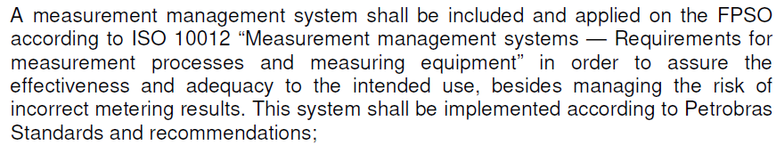
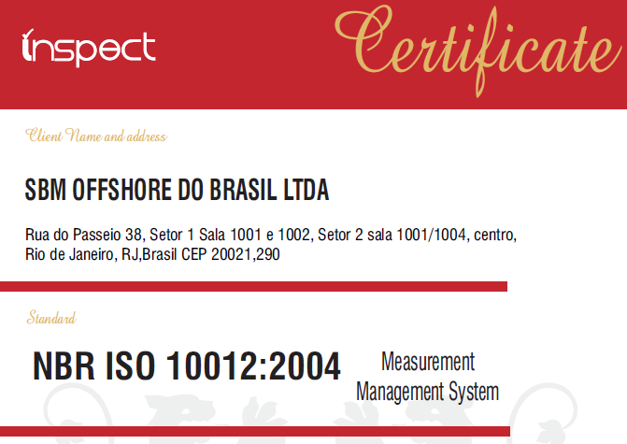
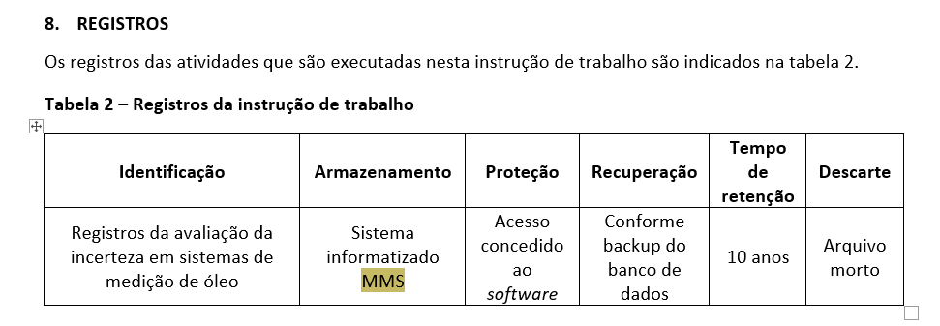
Context – Timeline
Regulatory Requirement
GTD Requirement
Certification
MOTIVATION
Reference to software use

Slide 4



Context – Metering Team R1
Main fleet and strong presence in Brazil
Closer to oil majors (Petrobras, Shell)
Strong regulatory watch from Government – ANP, INMETRO, etc.
BRAZIL
Main Goal to have zero fines from regulators related to Metering
Dedicated metering team with 7 engineers and 1 analyst managing R1 fleet, reporting to Metering Lead, Maintenance Manager and Asset Integrity Manager
22 offshore metering technicians
Ensure full compliance with strict Metering regulation for all units in R1
METERING
FPSO Sepetiba
First Oil
31st Dec 23
NEW UNITS
FPSO Almirante Tamandaré
First Oil
15th Feb 25
FPSO Alexandre de Gusmão
First Oil
24th May 25
Notes:
Kenny

Slide 5
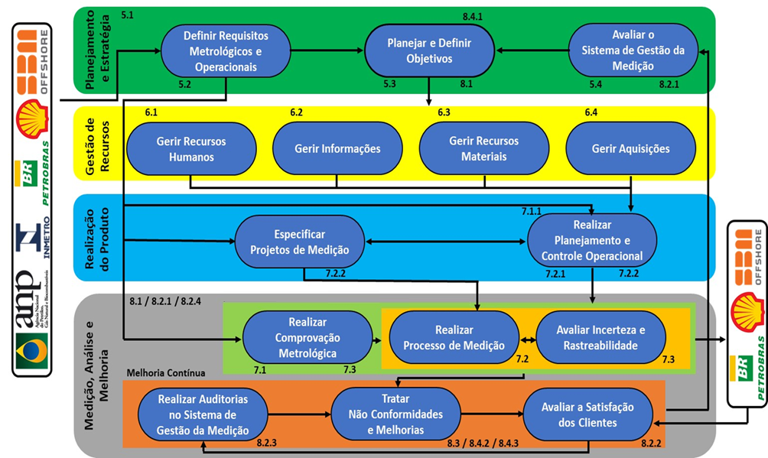
Concept & Design – Metering Process [AS-IS]
Strategy and Planning
Metrological and operational requirements definition
Objectives planning and definition
Management System Evaluation
Resources Management
Manage Human Resources
Manage Information
Manage Material Resources
Manage Acquisitions
Product Making
Metering Project Specification
Execute Planning and Operational Control
Operational Metrological Process
Product Metering
Execute Metrological Confirmation
Execute Metering Process
Evaluate Uncertainty and Traceability
Metering, Analysis and Improvement
Continuous Improvement
Execute Metering System Audits
Manage Non-conformities and Improvements
Evaluate Client Satisfaction

Slide 6
Concept & Design – Metering Process [AS-IS]
Strategy and Planning
Metrological and operational requirements definition
Objectives planning and definition
Management System Evaluation
Resources Management
Manage Human Resources
Manage Information
Manage Material Resources
Manage Acquisitions
Product Making
Metering Project Specification
Execute Planning and Operational Control
Operational Metrological Process
Product Metering
Execute Metrological Confirmation
Execute Metering Process
Evaluate Uncertainty and Traceability
Metering, Analysis and Improvement
Continuous Improvement
Execute Metering System Audits
Manage Non-conformities and Improvements
Evaluate Client Satisfaction

Slide 7
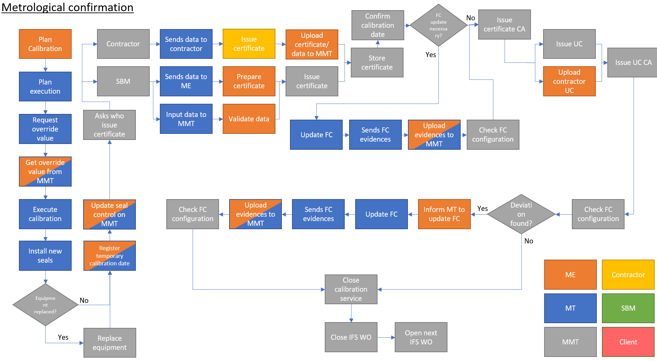
Concept & Design – Metering Process [AS-IS]
Metrological Confirmation
Complex flow of information
Multiple actors including third party, SBM engineer onshore, metering technician offshore
Most critical regulatory activity due to high volume of calibrations (~200/month)
Managed partially by IFS, but not compliant with regulation; Multiple process done on in-department developed spreadsheets

Slide 8
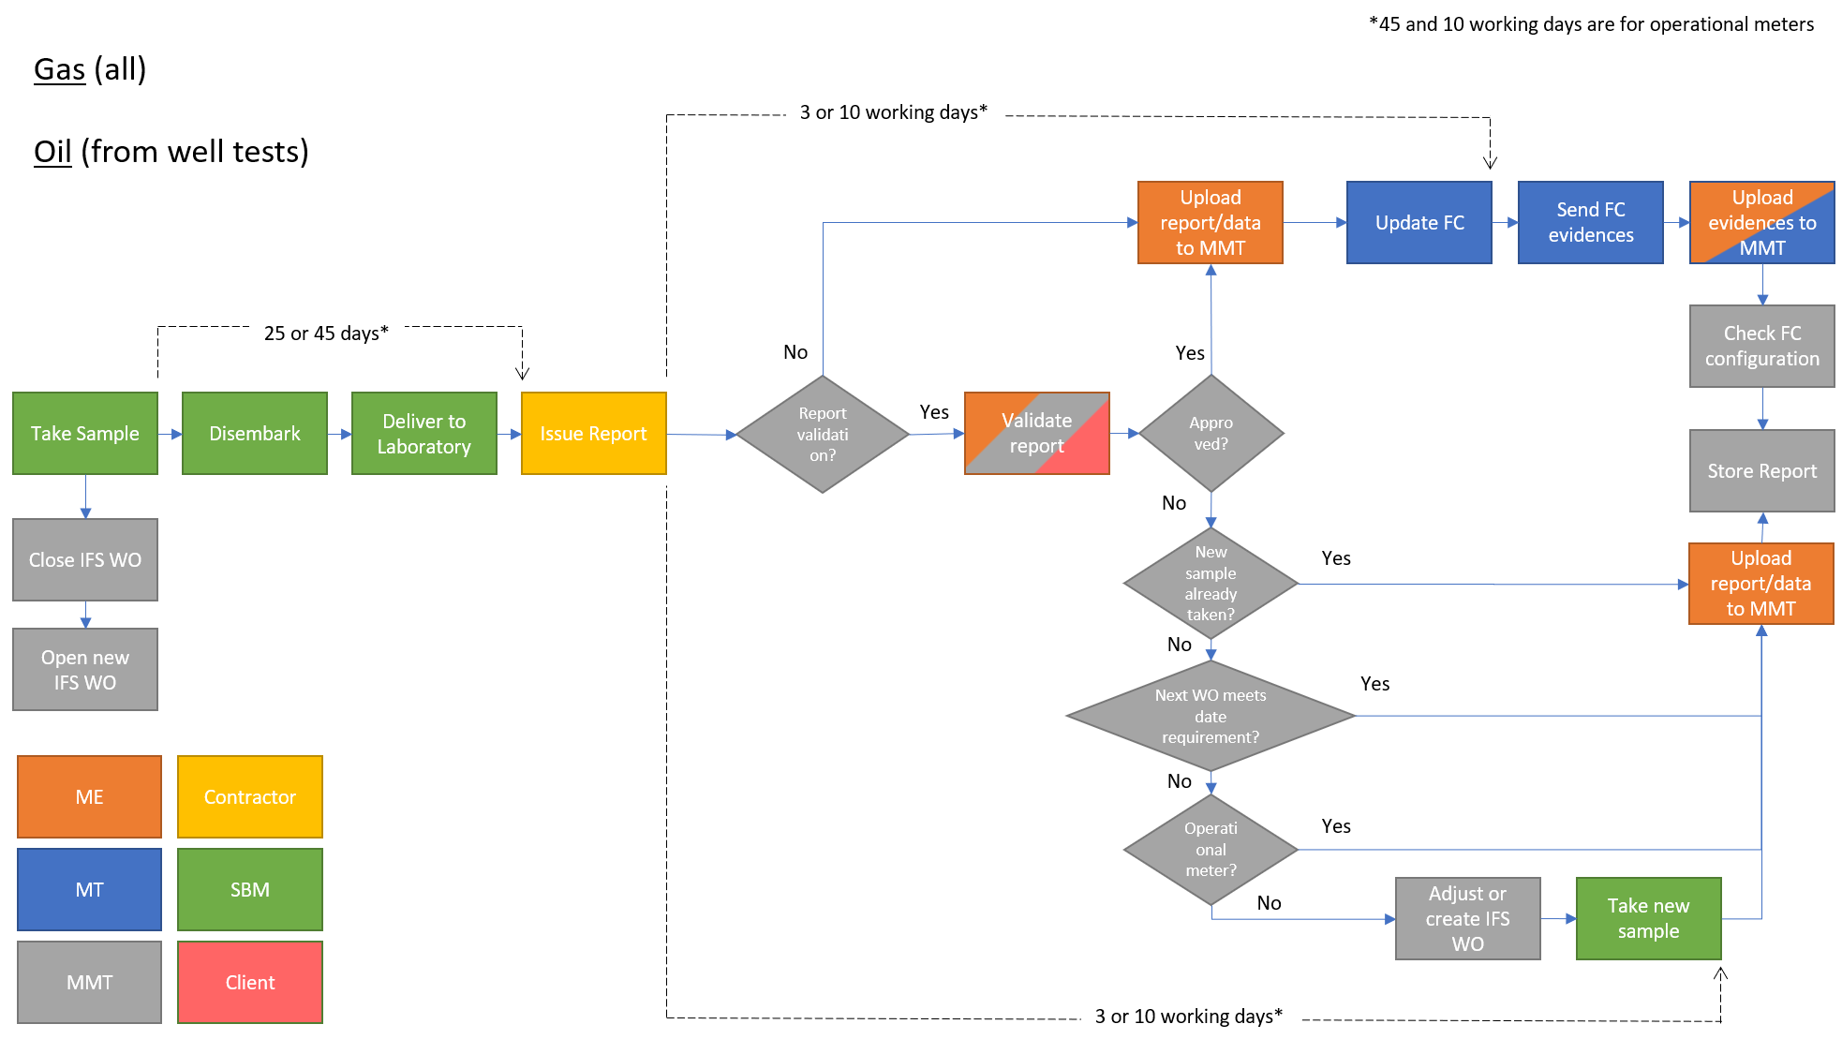
Concept & Design – Metering Process [AS-IS]
Sampling Oil / Well Gas
Multiple deadlines depending on type of sample and results
Multiple actors, including client validation
Around 50 process on-going simultaneously each month
Critical activity requiring offshore control system to be updated and checked in a very short time
No official SBM system to manage; Control 100% on spreadsheets developed on the department

Slide 9






High Level Flow of Information [AS-IS]
1
*Brazilian fleet per month
Calibration data 360+
Metering
Technician
Offshore
Audit Trail Evidences 500+
Reference for audits, clients and regulators
ANP XML Files 1000+ (official production figures)
Offshore Repository
Flow computer reports 700+
2
Uncertainty calculations 120+
In-house Tools
Calibration certificates 360+
Metering
Engineer
Onshore
Gas/oil analyses report 80+
Non-conformities and
Failures detection
Onshore Repository
Notes:
Kenny

Slide 10







Concept & Design – High-Level Architecture [TO-BE proposition]
SBM ENVIRONMENT
METERING TOOL
Update due dates / frequencies
Enable/Disable PM Actions
Metering Team
IFS
M5
M1
Filter information related to metering.
Data Sync with ICSS
M2
M4
M3
Flow Computers
Queries
&
Configurations
Update parameters
M6
M9
M10
M7
M8
M11
Notifications
File Sync
CONTROL PANEL
&
SETTINGS
FPSO
CORE functions
SUPPORTIVE functions

Slide 11
Concept & Design – Application Modules [TO-BE proposition]
M1 : Managing Equipment
M2 : Metrological Confirmation
M3 : Chemical Analysis
M4 : Onshore Maintenance
M5 : Synchronize Data
Metering Management System
M6 : Monitoring & Alerts
M7 : Export Data
M8 : Planning
M9 : Failure Notification
M10 : Historical Report
M11 : Configurations

Slide 12
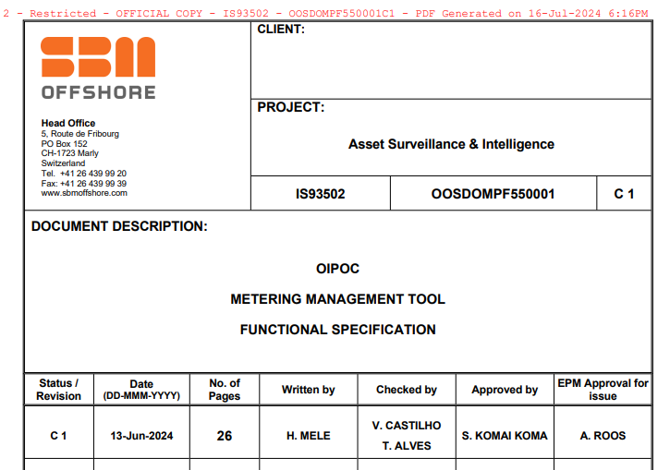
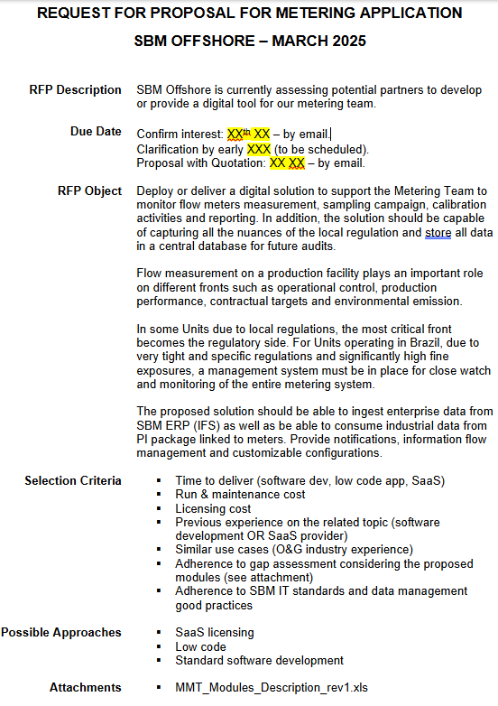
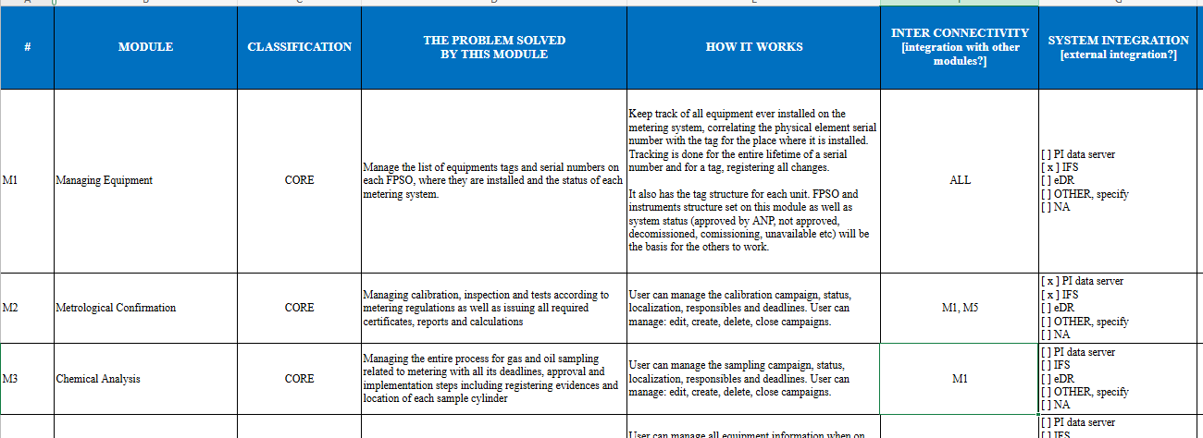
Functional Specification, RFQ and Modules Description Ready

Slide 13
Possible fines
Non-conformity | Cost per event
Serial number incorrectly changed | $30,000
Incorrectly reported data | $28,000
Incorrect flowmeter parametrization data | $225,000 - $250,000
Calibration completed after due date | $225,000 - $250,000
Calibration results implemented after due date | $225,000
Sampling completed after due date | $250,000
Sampling report issued after due date | $225,000
Sampling results implemented after due date | $250,000
Operate equipment beyond regulatory limits | $250,000
ANP audit forecast for 2026: 36,000 remote; 123 offshore

Slide 14
Historical Fines
FPSO | ANP Fine
Marlin Sul | US$4,000,000
Capixaba | $1,000,000
Paraty | US$200,000
Espírito Santo | US$27,000,000
Ilhabela | US$3,600,000

Slide 15
2025 Possible Exposures / Near Misses
FPSO | Description | Exposure
CDM | Gas composition updated 6 hours after deadline (5 occurrences at once, as this is a batch process) | $120,000 - $1,000,000
ATD | Flowmeter calibration curve updated 12 hours after deadline | $225,000
SEP | Prover calibration data updated after deadline | $225,000
CDS | Failure notification sent after the 72 hours deadline | $30,000

Slide 16








Key Objectives for this integration into PACE
Improve operations through intelligent automation, simplifying processes and allowing engineering teams to focus on strategic work and operations priorities instead of manual tasks. Indicators targeted with this initiative:
Automated Availability Status
70% Manual Effort Reduction
Definition of equipment availability status automated.
Manual tasks for status consolidation have significantly decreased, reducing workload without adding headcount.
Natural Scalability
Data quality surveillance
New way highlights gaps in original sources and reinforces corrections at their origin, improving the overall process.
Solution scales effortlessly with fleet size and across different Regions.

Slide 17




Manhours savings – Metering Technician
DAILY
WEEKLY
MONTHLY
2 hours
daily
1,4 hours/day
2,0 hours/week
5,0 hours/month
ANP production reports
Trend evaluation for failure notifications
Oil density update
EST-TOG report
Offloading density update
Issue failure notifications
Update ANP book
Override variables for calibration
Prepare flow computer for well test + reports
Update gas composition
Update calibration curve
Update dimensional inspection

Slide 18
Manhours savings – Metering Engineer
DAILY
WEEKLY
MONTHLY
1,5 hour
daily
1,0 hours/day
2,5 hours/week
3,0 hours/month
Download ANP Reports
Manually load reports on Access/Excel tool
Check density updates
Check trends for failures
Check Excel tool alerts
Check offloading density update
Issue failure notifications
Update ANP book
Override variables for calibration
Check gas composition update configuration
Check calibration curve update configuration
Check dimensional inspection update configuration

Slide 19
Manhours savings – Metering Analyst
DAILY
WEEKLY
MONTHLY
3,5 hour
daily
3,0 hours/day
2,5 hours/week
2,5 hours/month
Manually update control spreadsheets
Send reports for validation / offshore update
Save reports / validation / evidences to storage folders
Issue TOG report
Update weekly KPIs
Cylinder stock management
Update department monthly reports (BI)
Report sampling status to client

Slide 20

Quantifying the Impact: Manual Effort Baseline
These estimates are based on interviews, procedures and careful assumptions, working closely with operational teams to accurately assess workload.
Target Fleet: Brazil fleet, encompassing 9 FPSOs.
Key Roles Surveyed: Metering Engineers, Metering Analyst and Metering Technician. These roles are central metering system management and operation
Survey Focus: Understanding the entire process and all tasks executed by the metering team to ensure compliance with regulatory requirements, pinpointing manual activities and complex process enforced only by individual knowledge of engineers, analyst and technicians.
The team spent about 7 hours weekly per FPSO manually consolidating files, saving reports, generating certificates, validating configuration with three employee involved: Metering engineer, metering analyst and metering technician.
1
2
3
Engineer Time Per FPSO
Monthly Effort
Annualized Workload
Engineer, technician and analyst, dedicating 7 hours/day per FPSO
Approximately 210 hours per month per FPSO for management and operation.
Over 2,500 hours annually per FPSO spent on manual processes.
This baseline highlights the substantial opportunity for efficiency gains through automation. By targeting this manual management, we can unlock considerable capacity.

Slide 21

Brazil Fleet Impact: Annual Savings and Reallocated Capacity
The FAST transition benefits all of Brazil's fleet, saving money annually and freeing engineering time for more valuable work.
Internal cost rating for Regional Engineer $150,00/hour applied.
Um slide para impacto reducao custo interno
Um slide para impacto financeiro das multas e exposicao
$5,760
$51,840
Monthly Saving Per FPSO
Brazil Fleet Monthly Saving
Direct cost reduction for each unit in the fleet.
Cumulative savings across all 9 FPSOs.
$622,08
4,147
Annual Saving
Engineering Hours Released
Total projected annual cost savings for the Brazil fleet.
Annual capacity reallocated from operations teams to higher-value activities.
These numbers highlight the FAST implementation's role in transforming manual work into major financial and workforce benefits.

Slide 22
Quantifying the Impact: Manual Effort Baseline
These estimates are based on detailed field surveys and careful assumptions, working closely with operational teams to accurately assess the manual workload.
Target Fleet: Brazil fleet, encompassing 9 FPSOs.
Key Roles Surveyed: Maintenance Engineers, Reliability Engineers, ASI Engineers. These roles are central to equipment status management.
Survey Focus: Understanding the manual search for information and manual data entries efforts to determine availability status. Furthermore, pinpointing the key features users appreciate most on OTM as well as the primary challenges they face.
The team spent about 4 hours weekly per FPSO manually consolidating equipment availability, with at least three engineers involved: Maintenance, Reliability, and ASI.
1
2
3
Engineer Time Per FPSO
Tentar consolidar em 1 slide, os slides 14, 15, 16 e 17
Monthly Effort
Annualized Workload
3 Engineers, each one dedicating 4 hours/week per FPSO
Approximately 48 hours per month per FPSO for status consolidation.
Over 576 hours annually per FPSO spent on manual processes.
This baseline highlights the substantial opportunity for efficiency gains through automation. By targeting this manual consolidation, we can unlock considerable capacity.

Slide 23
Brazil Fleet Impact: Annual Savings and Reallocated Capacity
The FAST transition benefits all of Brazil's fleet, saving money annually and freeing engineering time for more valuable work.
Internal cost rating for Regional Engineer $150,00/hour applied.
$5,760
$51,840
Monthly Saving Per FPSO
Brazil Fleet Monthly Saving
Direct cost reduction for each unit in the fleet.
Cumulative savings across all 9 FPSOs.
$622,08
4,147
Um slide para impacto reducao custo interno
Um slide para impacto financeiro das multas e exposicao
Annual Saving
Engineering Hours Released
Total projected annual cost savings for the Brazil fleet.
Annual capacity reallocated from operations teams to higher-value activities.
These numbers highlight the FAST implementation's role in transforming manual work into major financial and workforce benefits.

Slide 24
Takeaways & Global Scalability: A Model for Future Growth
Key Strategic Implications
Empowered Engineering: Engineers can now dedicate their time to critical analysis and decision-making, enhancing strategic output.
Proven Model and Scalability: The Brazil fleet demonstrates a successful, data-backed implementation and solution escalated to another Region, being ready for new enhancements to operations routines.
Future-Proofing Operations: Laying the groundwork for advanced operational capabilities across our entire global fleet and new integrations on PACE program to move from reactive to predictive maintenance approach.
Data-driven confidence: Focus to improve the data quality, the process and capacity of offshore and onshore teams
Sustainable Growth: Achieving efficiency gains that contribute directly to long-term profitability and sustainability.

Slide 25






Context – Timeline
Measurement Management System
(MMS) a SaaS owned by FocQus is used by the SBM Metering Team.
Due to MMS limitations, Metering Team needed to develop additional controls, such as, spreadsheets and databases in Access to manage R1 metering scope.
FocQus showed no interest in developing new features at reasonable prices to tackle the gaps at reasonable costs, therefore, Metering Team decided to not renew the SaaS and remain with current controls.
Metering team and DDI started the framing for another metering tool that is flexible, customizable and tackle the missing points from the previous MMS.
The future MMS tool will be able to provide a seamless experience for the Metering Team, providing notifications, reports and integration to SBM systems.
1
2
3
4
5
Current State
Future State

Slide 26

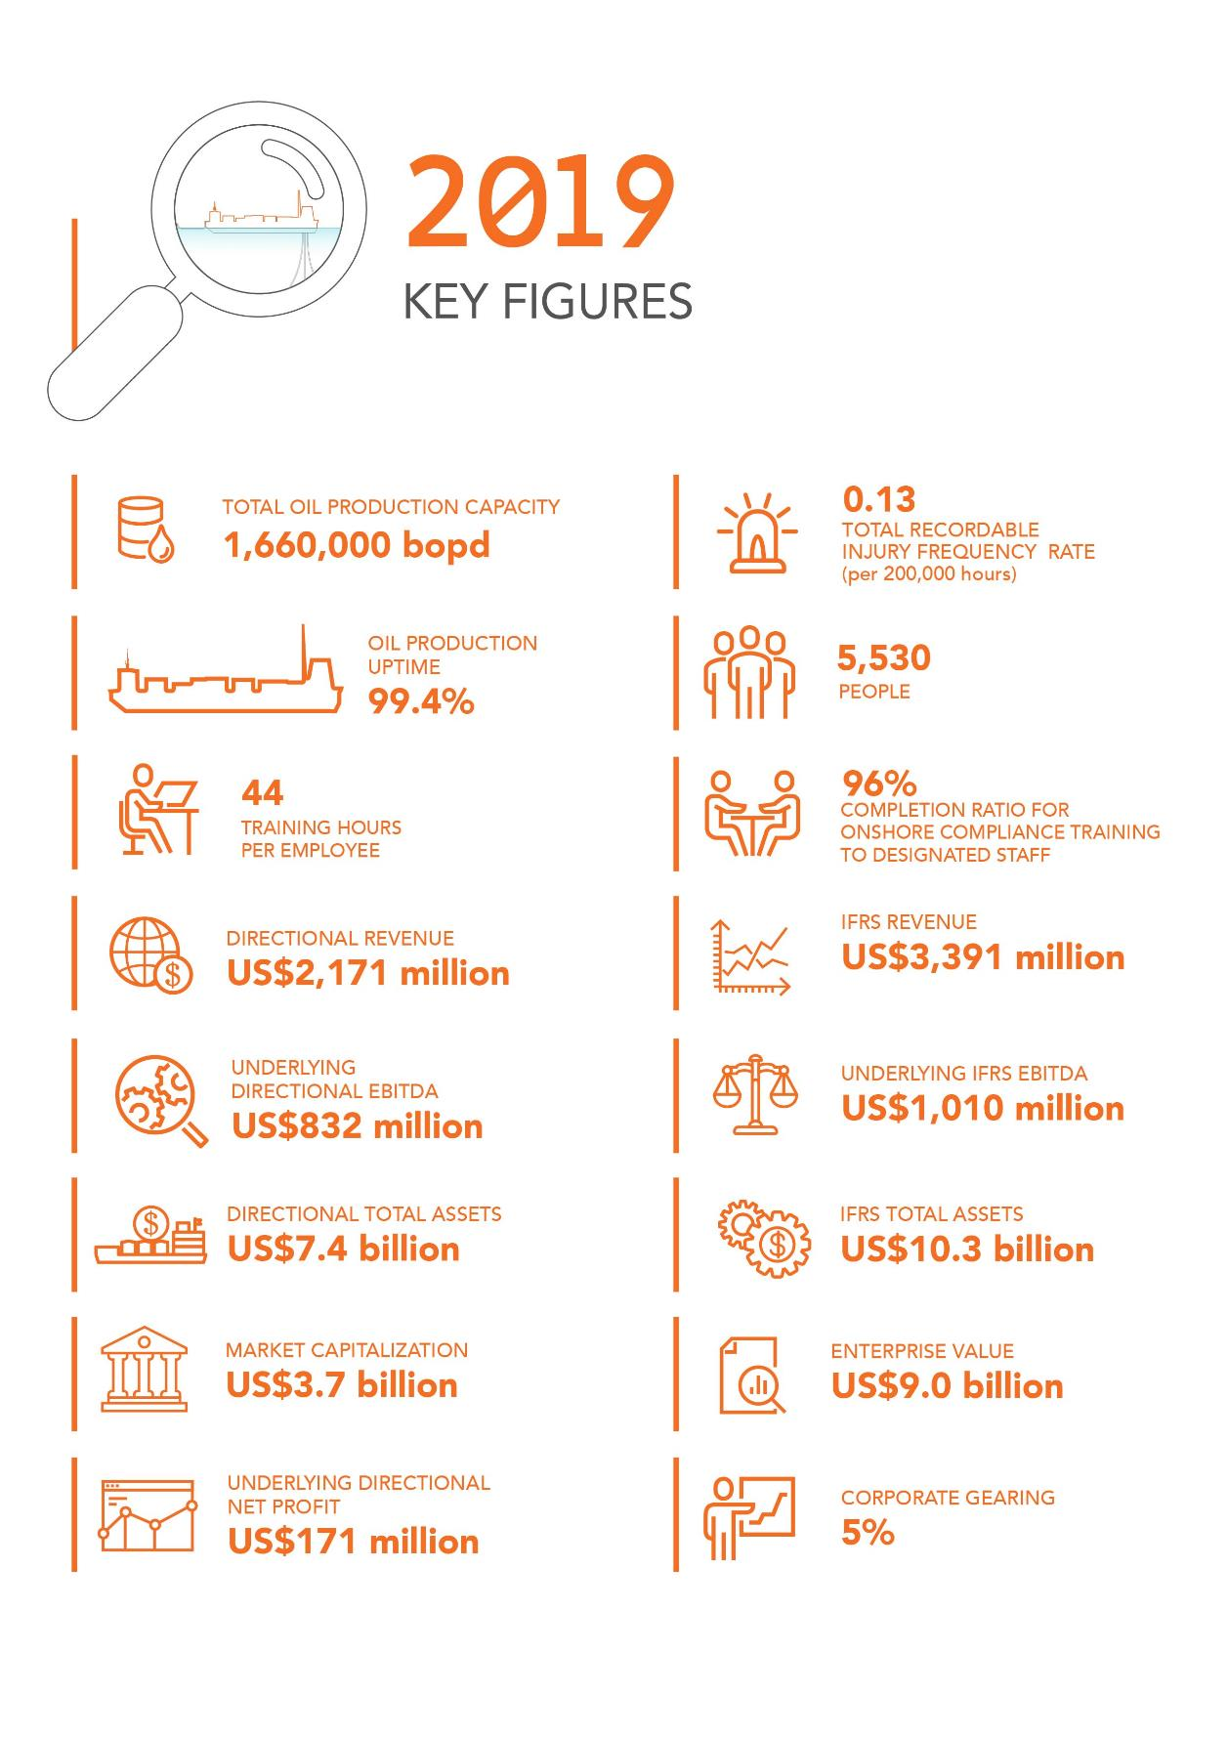
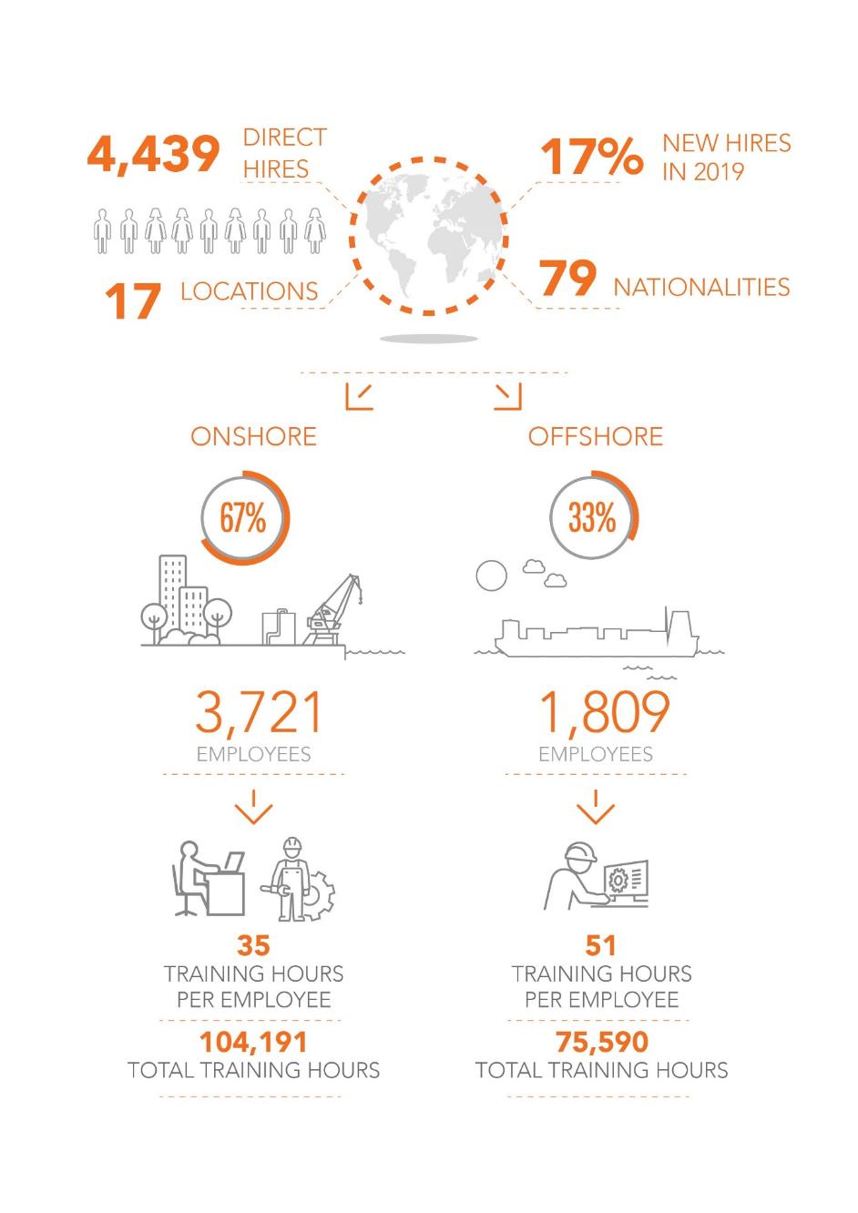


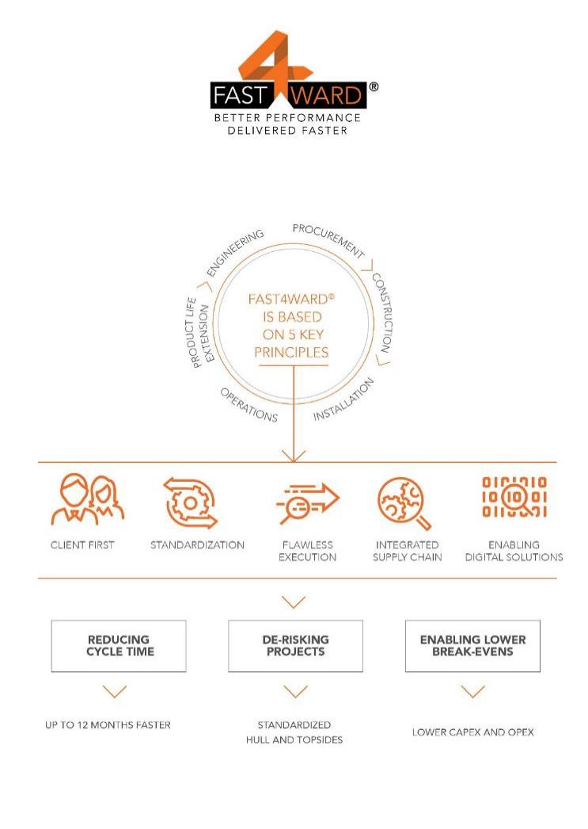
Context – Problem Statement
9 FPSO
212 flow computers
Over 400 daily reports and parameters files
SCOPE OF WORK
2900 regulated equipment
More than 1 Million critical
parameters evaluated every day
Notes:
Kenny

Slide 27
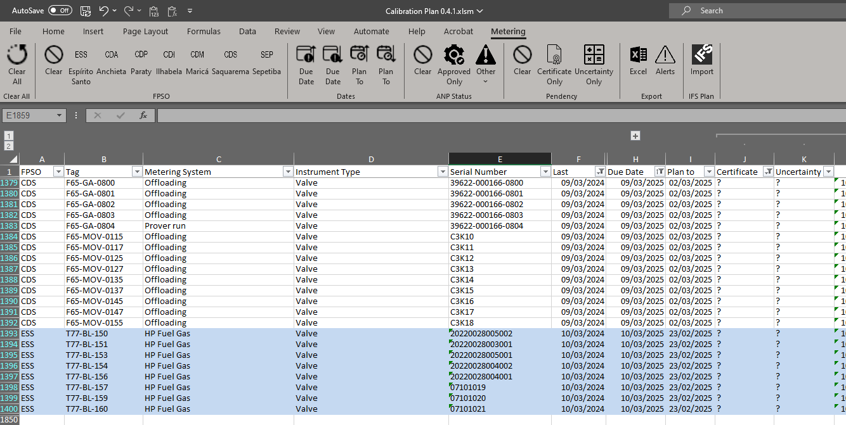
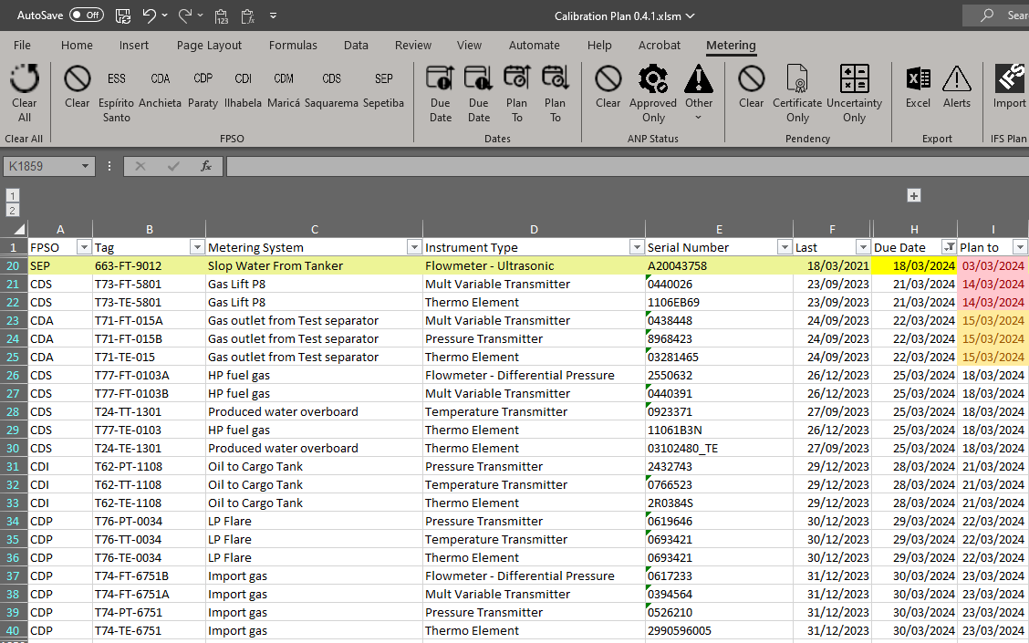
Example of Metering Spreadsheets
→ Tools developed in-house to help engineers on the day to day work, assisting filtering, data entering and IFS integration

Slide 28
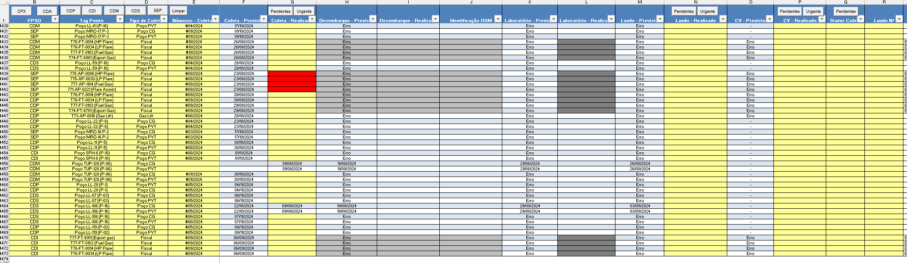
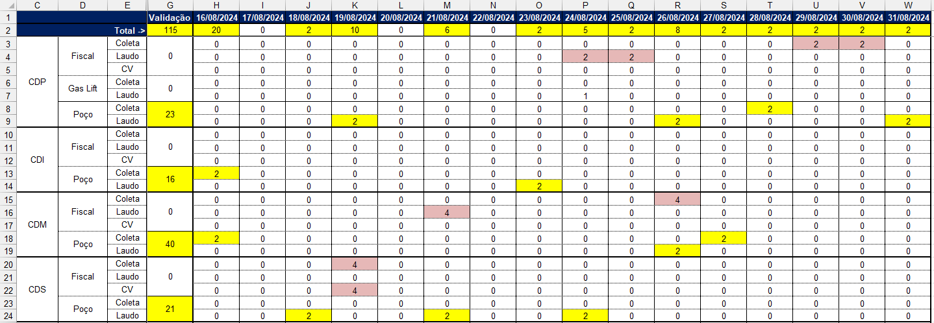
Example of Metering Spreadsheets
hhh
→ Gas/Oil sampling control and forecast for each regulatory activity over next 14 days

Slide 29
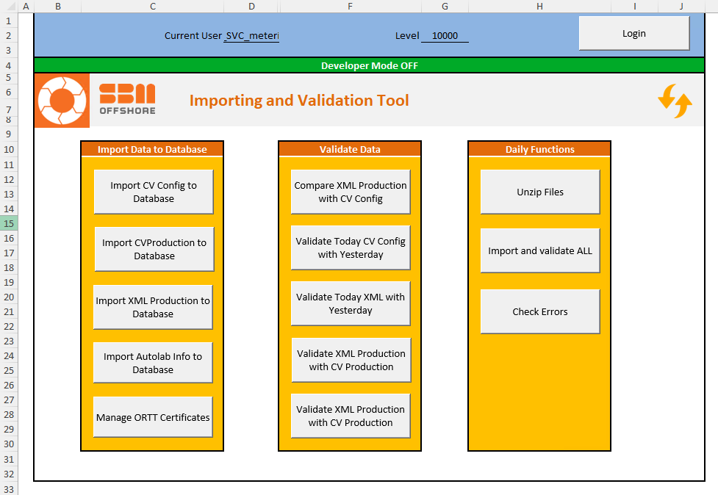
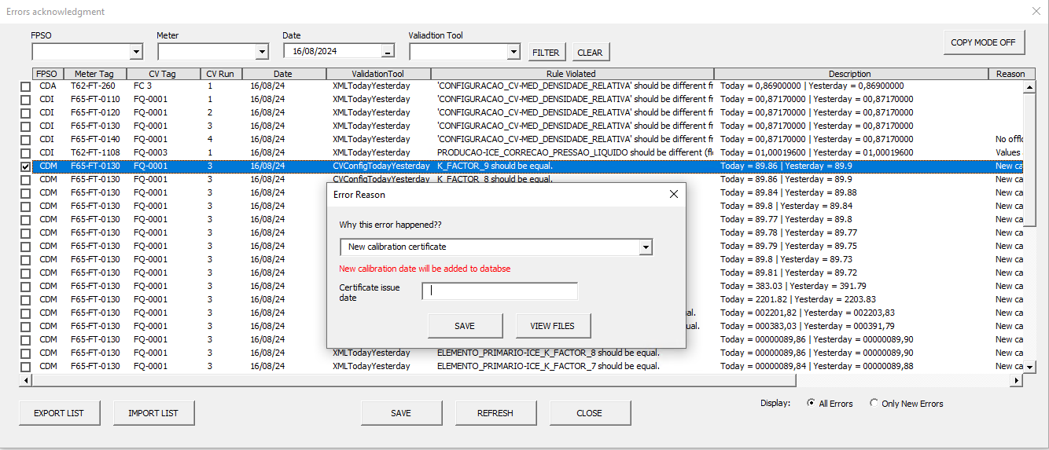
Example of Metering Spreadsheets
Tool developed on the department using Excel VBA + Access to monitor +1 million parameters every day based on offshore data
All deviations are analyzed and justified by engineers

Slide 30
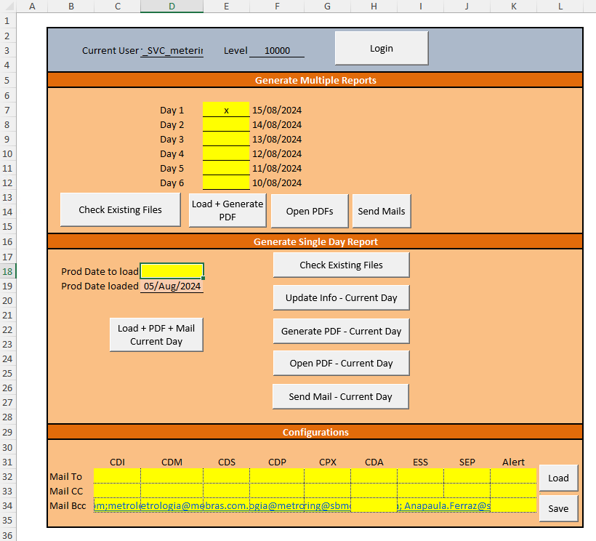
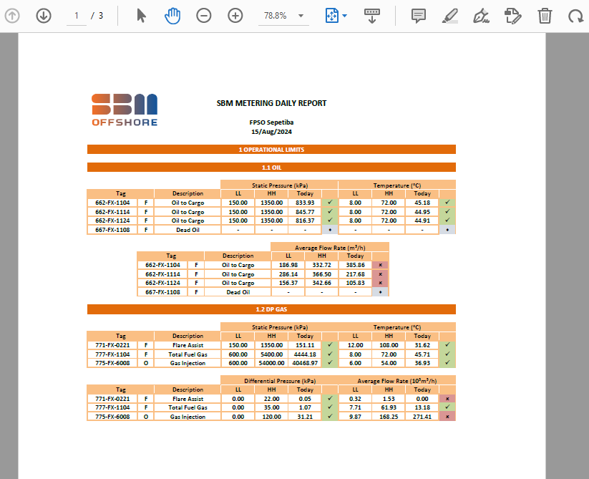
Example of Metering Spreadsheets
Using the same data, another tool developed on the department generates a summarize report with the overall condition on the metering system

Slide 31
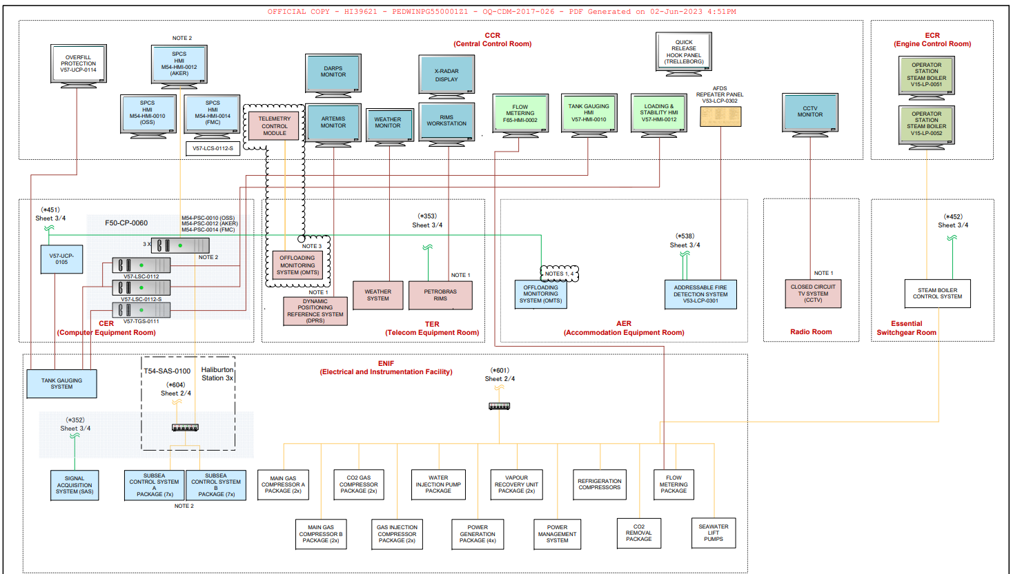
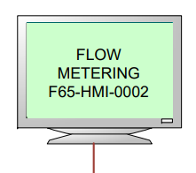
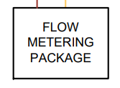
Flow of Information Detailed – 1 & 2 [AS-IS]
1
Calibration data 250+
Metering
Technician
Offshore
Audit Trail Evidences 500+
ANP XML Files 1000+ (official production figures)
Offshore Repository
CCR example - CDM
Metering
Technician
Offshore
ICSS
Calibration Data: Enter Calibration Data inputs.
Gas and Oil Analysis Reports: Enter Gas and Oil analysis results from laboratory reports.
Computer Logs: Daily Logs are created containing all relevant information. ANP XML Files.
Notes:
Kenny

Slide 32
Flow of Information Detailed – 1 & 2 [AS-IS]
ICSS Network
DMZ
IT Network
Office Network
NAS Package
NAS IT
ICSS Workstation
Metering
Technician
Offshore
2
Metering
Engineer
Onshore
Automated Scheduling and scripting
by e-mail
Softwares used in XML generation:
CDA - Strack
CDI,CDS,CDM – ODS (old version)
SEP, ATD, ADG - ODS (new version)
CDP - Emerson
ESS - Focus

Slide 33





DDI – Make or Buy – Market Analysis
Company
Product
Website
ODS
MOMS
ods-metering-systems.com
FocQus
MMS / FMS
www.focqus.com
Strack
Cosmos
www.strack.com.br
Automind
Automed
www.automind.com.br

